Slide 1
Getting Started on Building Tables
Using SSMS and SQLCMD
Data Dictionary
Data Types

Slide 2
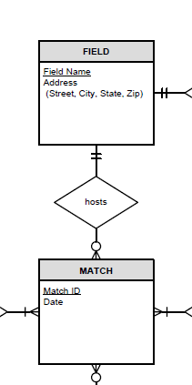
Data Dictionary: (Convert RS to DD Chart/Matrix) Elements you need to know to get started
Table: Field
Column Name | Description | Data Type | Size | Identity | Unique | Default | Check | Rule | Allow Nulls | Index
FieldName | PK; Unique field name | varchar | 20 |  |  |  |  |  |  | Y
Street | Field street | varchar | 30
City | Field city | varchar | 25
State | Field state | char | 2 |  |  | ‘FL’ | LIKE ‘[A-Z][A-Z]’
Zip | Field zip | char | 5 |  |  |  | LIKE '[0-9][0-9] [0-9][0-9][0-9]'

Slide 3
Choosing Data Types
Char, nchar, varchar, nvarchar, (MAX):
What to choose and why?
https://www.mssqltips.com/sqlservertip/4322/sql-server-differences-of-char-nchar-varchar-and-nvarchar-data-types/
Decimal or Numeric or Money?
https://blog.learningtree.com/is-money-bad-the-money-datatype-in-sql-server/
https://docs.microsoft.com/en-us/sql/t-sql/data-types/data-types-transact-sql?view=sql-server-ver15

Slide 4
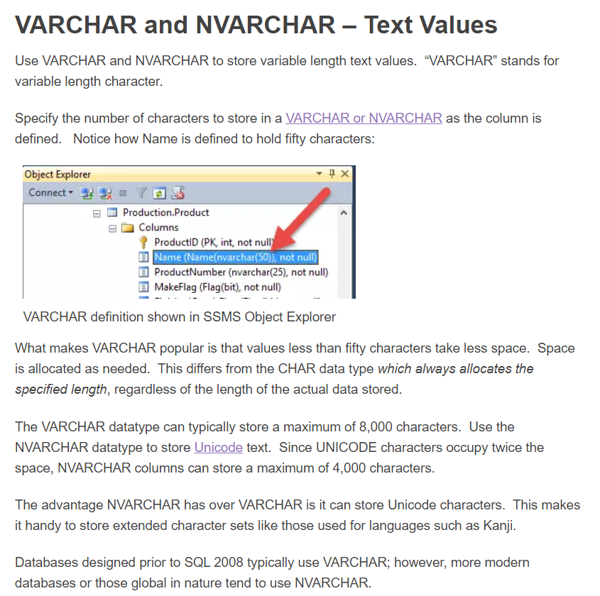

Slide 5
Properties: Definitions and Terms to get you started
Identity (auto generated) – Surrogate PK
Seed and increment
Default value
Auto filled by SQL Server, when you hit tab or when value not in insert statement
Naming (indexes and Constraints)
PK_Index, AK_Index, UN_Index, IX_Index
CK_check
CN_constraint (rule, default, check)
PK-FK Relationship
FK_ForeigntablePrimarytable

Slide 6
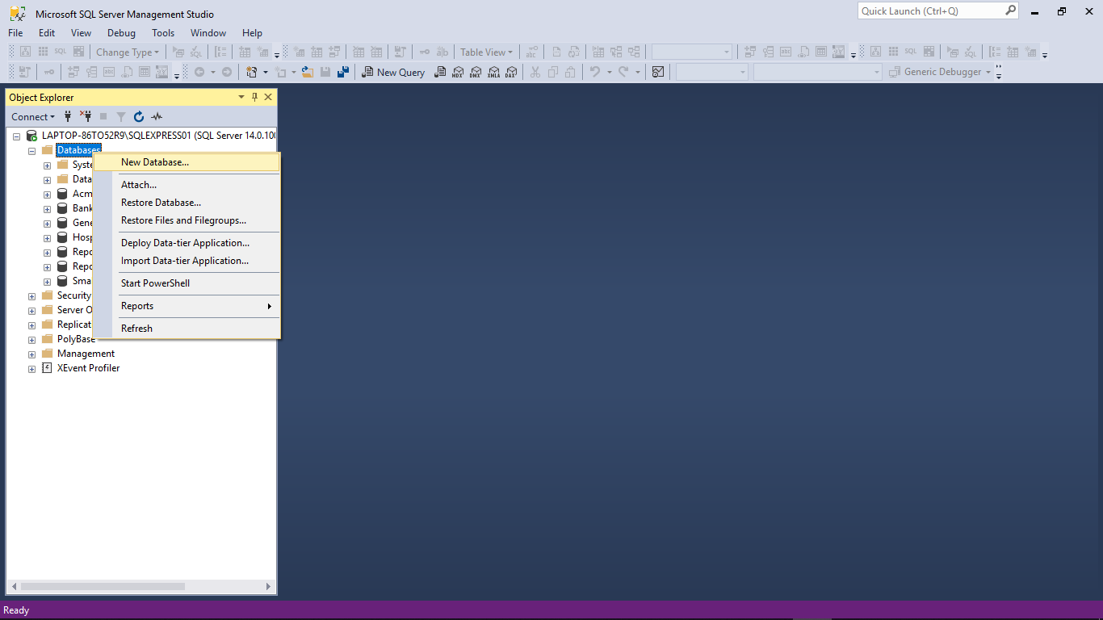
Getting Started with SSMS: Create New Database

Slide 7
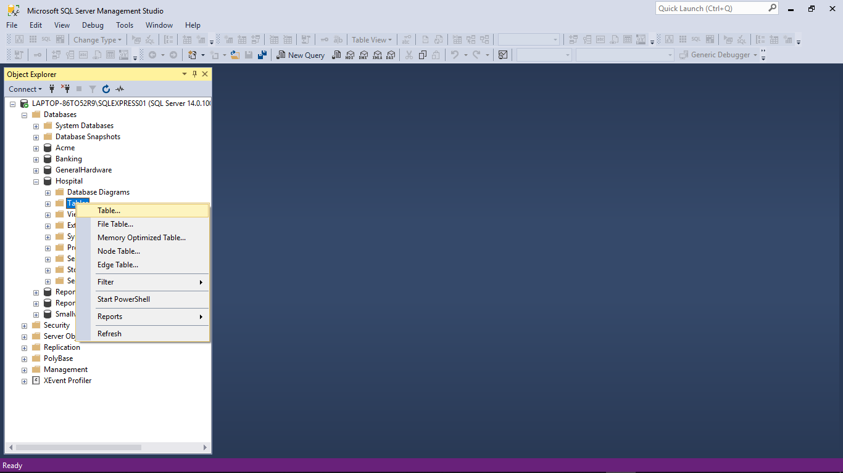
Building Tables with SSMS: Create New Table

Slide 8
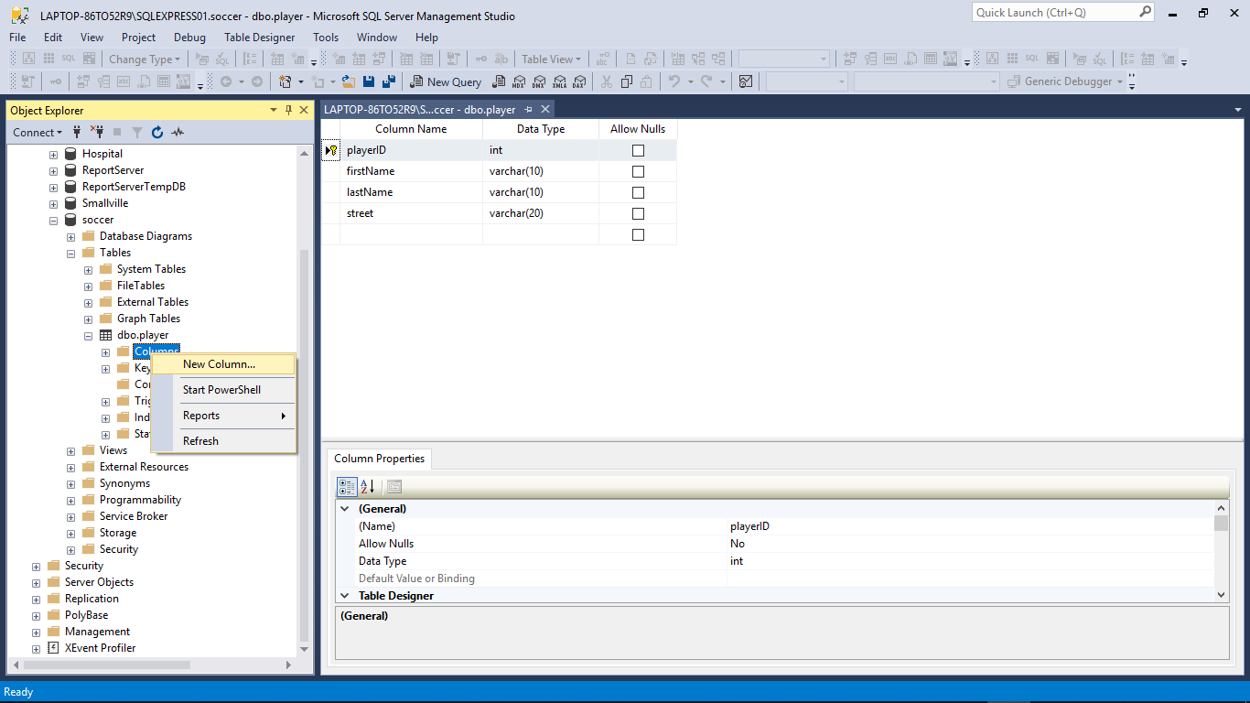
Add columns to your table

Slide 9
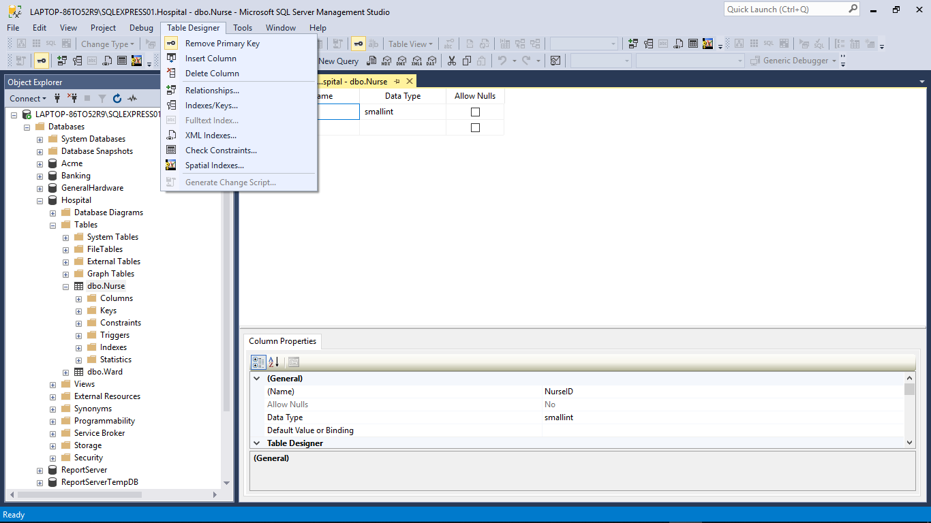
Alter Tables with SSMS: Table Designer, Properties
Column properties versus table properties

Slide 10
Data Dictionary: Why you need these items
Table: Field
Column Name | Description | Data Type | Size | Identity | Unique | Default | Check | Allow Nulls | Index
FieldName | PK; Unique field name | varchar | 20 |  |  |  |  |  | Y
Street | Field street | varchar | 30
City | Field city | varchar | 25
State | Field state | char | 2 |  |  | ‘FL’ | LIKE ‘[A-Z][A-Z]’
Zip | Field zip | char | 5 |  |  |  | LIKE '[0-9][0-9] [0-9][0-9][0-9]'
Table: Match
Column Name | Description | Data Type | Size | Identity | Unique | Default | Check | Allow Nulls | Index
MatchID | PK; Unique sequential match ID number | smallint |  | Y |  |  |  |  | Y
Date | Date match scheduled | date |  |  |  |  | >= GETDATE()
FieldName | FK to Field table; location of match | varchar | 20

Slide 11
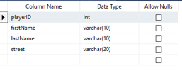
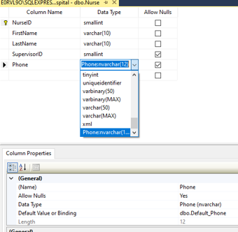
Let’s take a closer look at data types
A lot of interesting things going on here

Slide 12
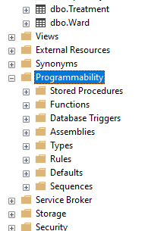
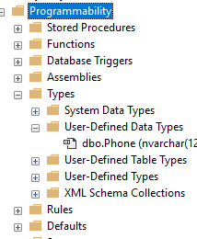
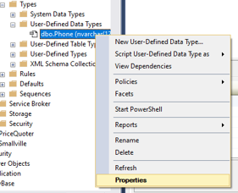
User-Defined Data Types

Slide 13
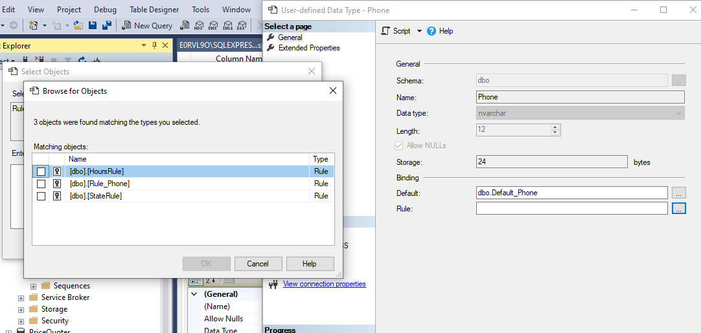
Set the properties and constraints (rules, defaults)

Slide 14
Now you have a customized data type to constrain your column

Slide 15
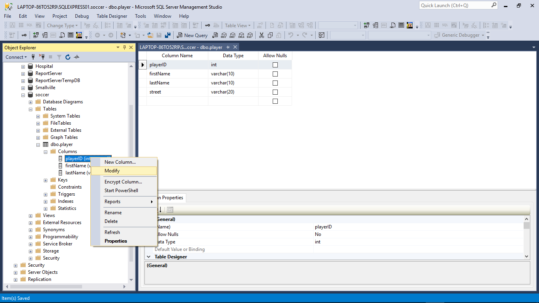
Now let’s Alter some more constraints on our Table

Slide 16
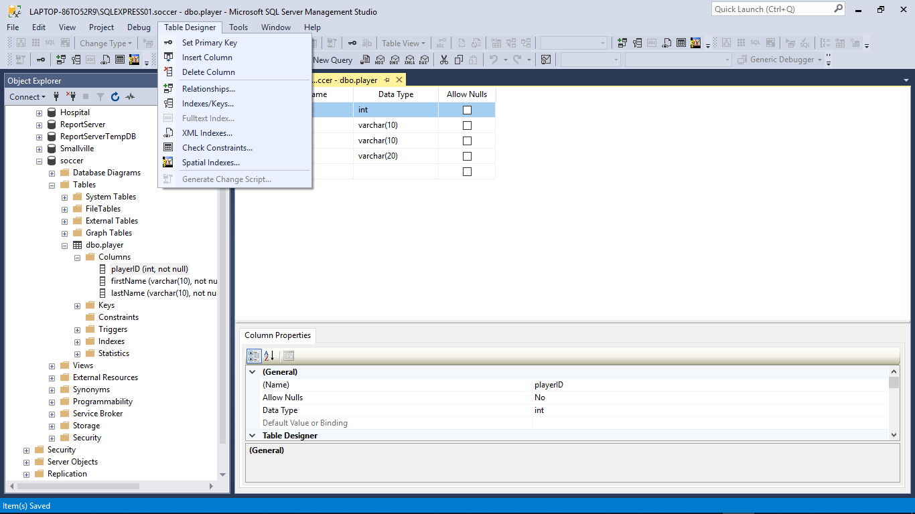

Slide 17
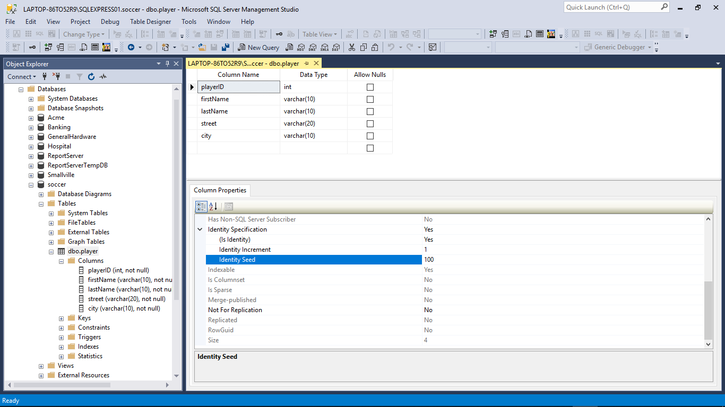

Slide 18
We have now: - created a table - added columns - set constraints - altered the table Next, let’s: - add records - run queries

Slide 19
Entering Data and Running Queries
Entering Data/records
SSMS (edit rows)
SQLCMD (Insert statement)
Queries
New Query (SSMS)
Select statement (select, from, where)
SQLCMD

Slide 20
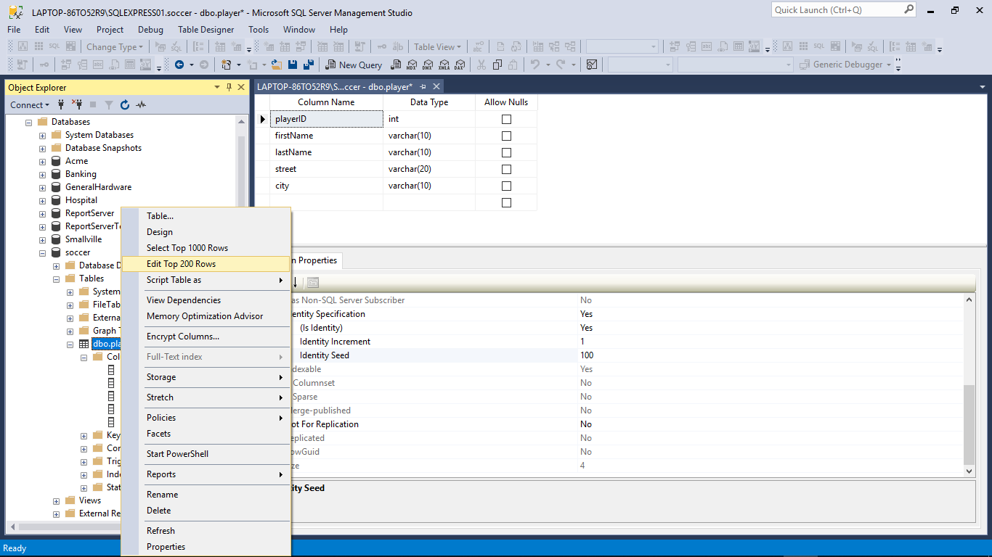
Manual insert of record using SSMS

Slide 21
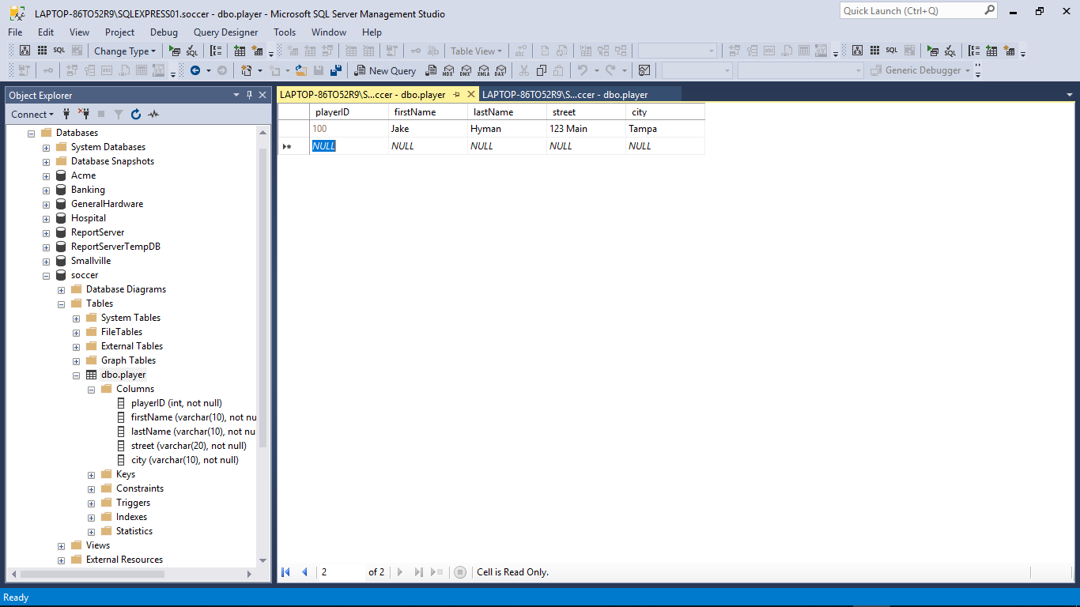

Slide 22
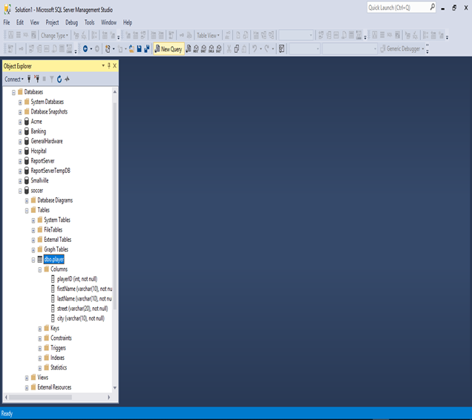
Let us run a query now

Slide 23
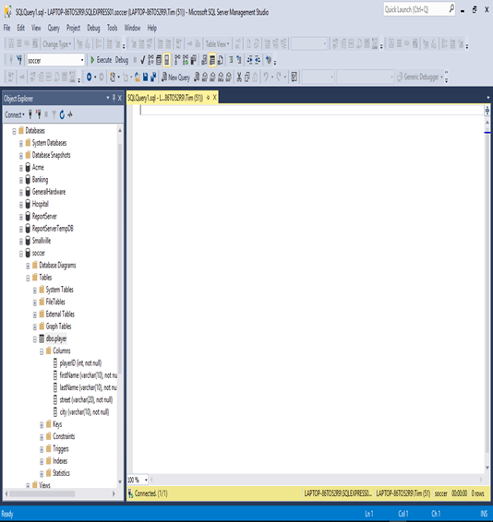

Slide 24
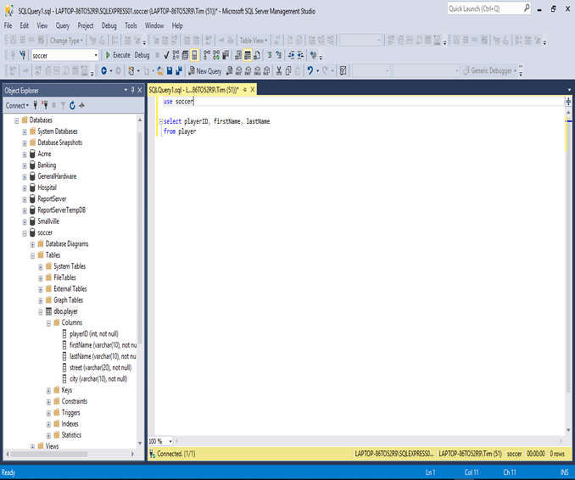
use soccer
select playerID, firstName, lastName
from player

Slide 25
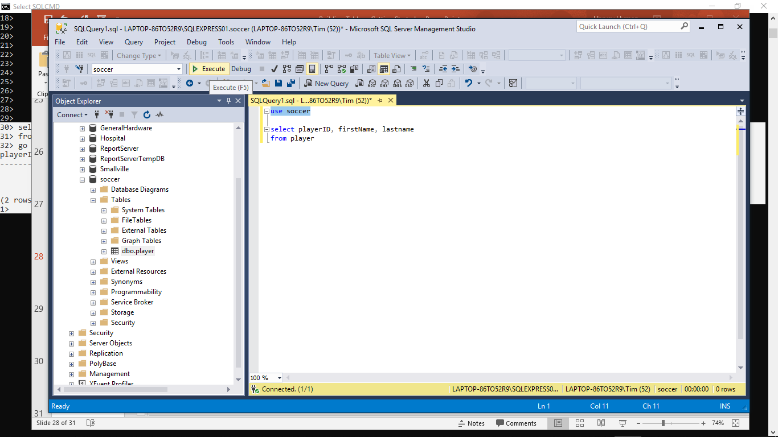

Slide 26
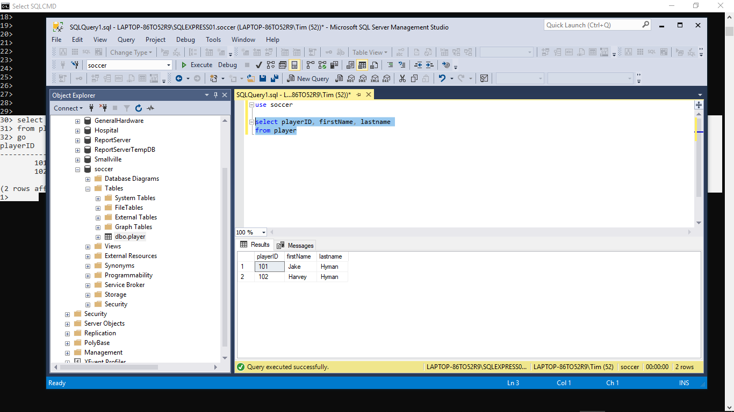

Slide 27
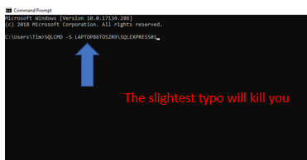
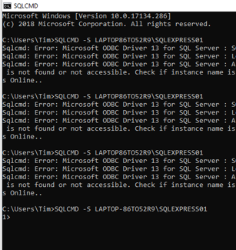
Getting Started with SQLCMD
Good to go

Slide 28
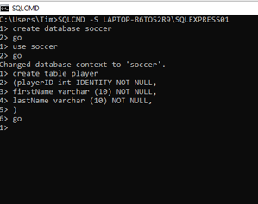
Let’s create a Database named ‘Soccer’ and create a Table named ‘Player’ with some columns, in the database…

Slide 29
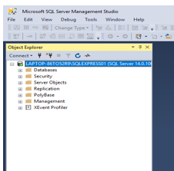
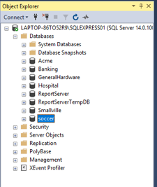

Let’s see if its there…

Slide 30
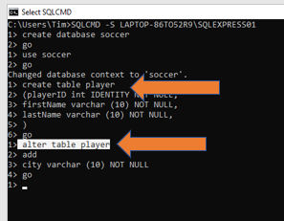

Let’s add a ‘City’ column to the ‘Player’ table

Slide 31
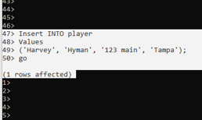
Let’s add a record to the ‘Player’ table
DML
Insert
INTO
Values
(‘literals’);
Identity so I do not include it in INSERT statement
Notice additional column
4 values and 4 columns

Slide 32
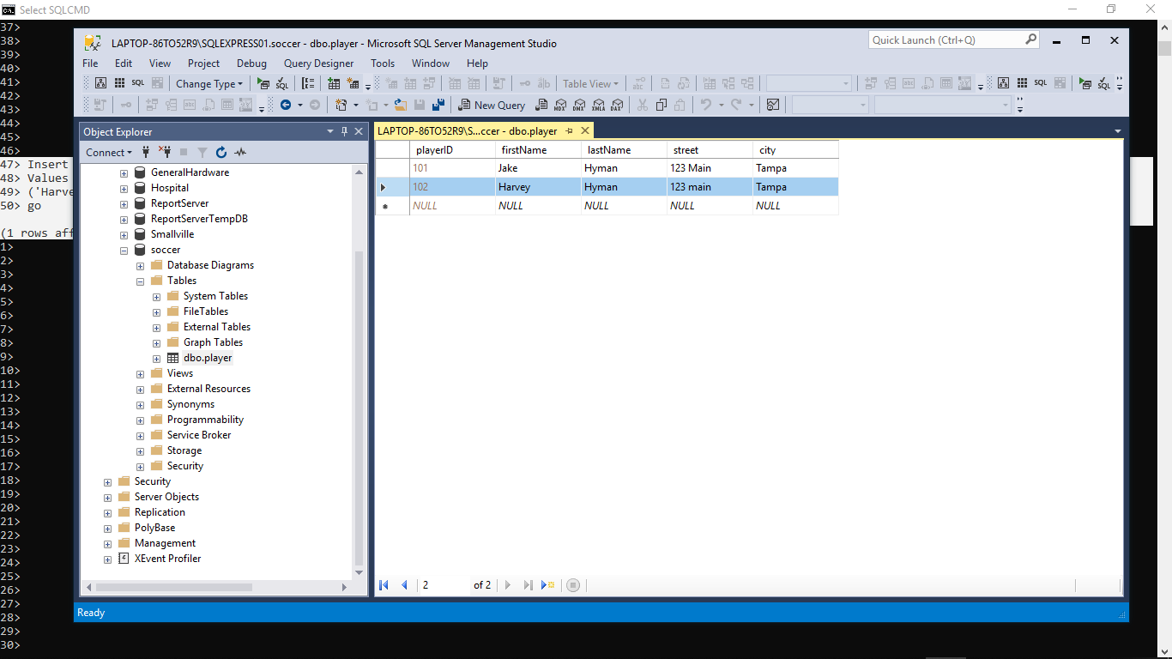
And you know who Bob is

Slide 33
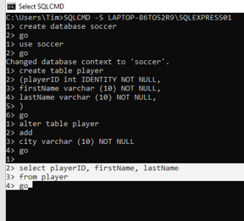
Let’s ask a question (query): Show me all player ID numbers, first names, and last names
DML
Select col1, col2
From table
Where condition
Order by sort

Slide 34
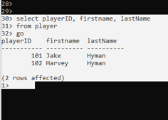

Slide 35
You have everything you need to get started now: - Practice Building Tables with: Hospital or ACME If you are really advanced then try putting it all together with: Dog Salon, Clothing Store

